Slide 1
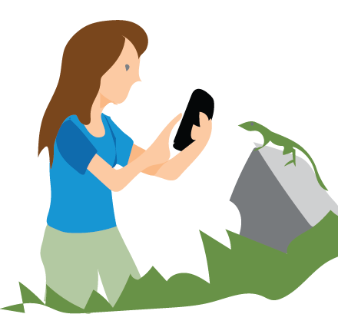
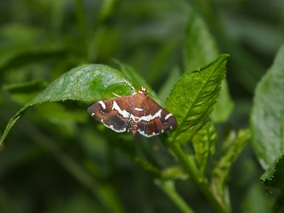

STREAM 2 : RECOMMENDING VISUALLY SIMILAR INSECTS
Not to be copied
DEEP
LEARNING
MODEL

Slide 2
TARGET
OUTPUT IMAGES
Not to be copied

Slide 3
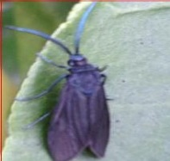
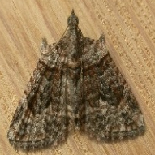
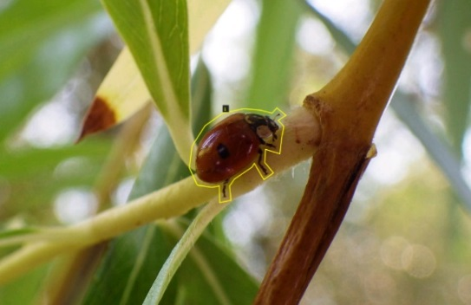
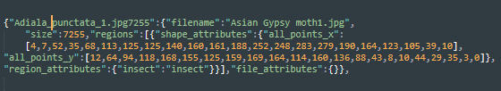
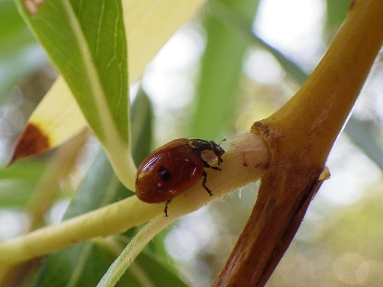
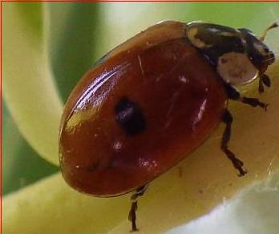
STEP 1 : OBJECT LOCALISATION
Input : Step 1
Step 1
Mask RCNN
(Mask Region Convolutional Neural Network)
Object Localisation
3600 Images
Class : Insect
Cropped image
Annotation JSON file
Python, Keras, Tensorflow
Python, Keras, Tensorflow
Not to be copied
VGG Software
VGG Software : For Annotation
Step 1 A
MASK RCNN MODEL
Training
&
Validation
Weights Generated
Annotation Data : JSON File Required as an Input for Mask R-CNN
FOR 3600 IMAGES
( MANUALLY )
Step 1 B
INPUT IMAGE
Output : Localised Insect
MASK RCNN
MODEL
INFERENCE
Output : Step 1

Slide 4
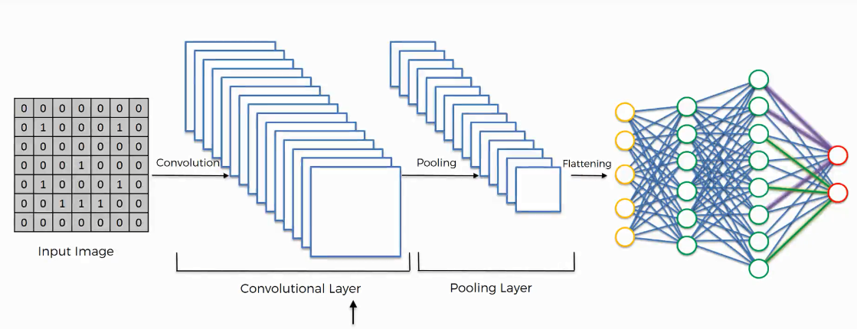
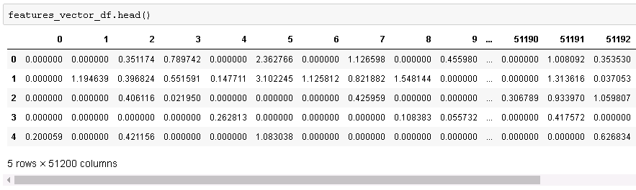
STEP 2 : CREATING FEATURE VECTORS DATASET
Output : from Step 1 Localised Insect Images
Convolutional Neural Network (Inception V3), Imagenet weights.
Feature vector extracted from flattened layer
Creating Dataset of Feature Vectors of Images
(a csv file)
Python, Keras, Tensorflow
Not to be copied
Output : Step 2

